Slide 1



ANDROID FILE MANAGER
GROUP # 01
Group Members:
Suhana Islam (2131550642)
Birjis Afroz (2212403642)
Rayeed Aabir Ahsan (2212905642)
Tanvir Rahman Onik (2212778042)

Slide 2


INTRODUCTION
This is a simple file manager app built using Kotlin for android devices. This app allows users to browse any type of files and folders stored in their android device. This application provides an easy-to- use GUI for the file management system. Users can perform basic crud operations via simple clicks on their android device.

Slide 3
TOOLS AND FRAMEWORK
This application was built using following tech stack:
Android Studio (IDE)
Kotlin( as programming language)
SQLite(as local database)

Slide 4
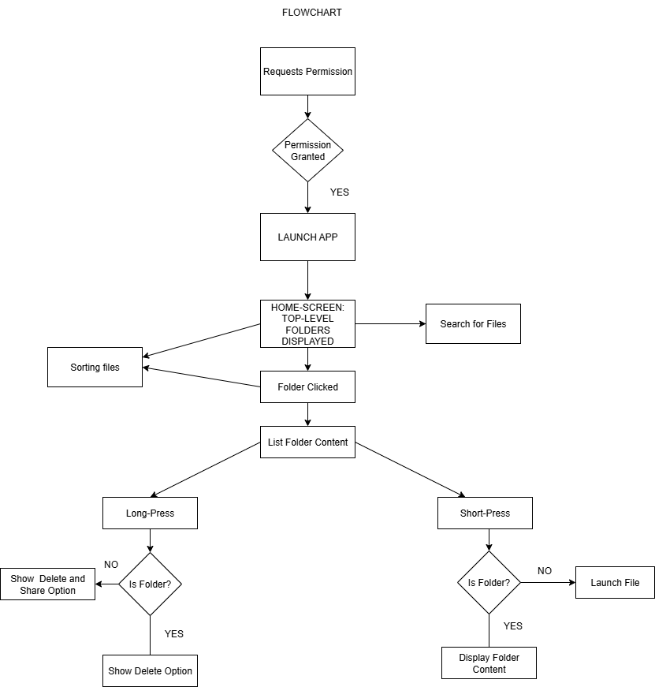

Slide 5
FEATURES
The files and folders present in the users’ android devices can be viewed.
Folders and their subfolders can be opened and browsed through.
Files and folders can be searched by their respective names and extension type.
Files can be sorted by their names, size and extension.
Short-press on a file will prompt the user to open it with the appropriate application.
Long-press will allow file sharing via gmail and whatsapp.
Any selected files can be deleted from the device if wished to.
Files are hashed and stored allowing any changes to be detected.

Slide 6
BENEFITS OF THIS APP:
Faster access and organization of files
Convenient to search files
Share files via Gmail, WhatsApp, or other installed apps
Clean, intuitive UI with RecyclerView for smooth scrolling
Recently modified files are highlighted for easier identification

Slide 7
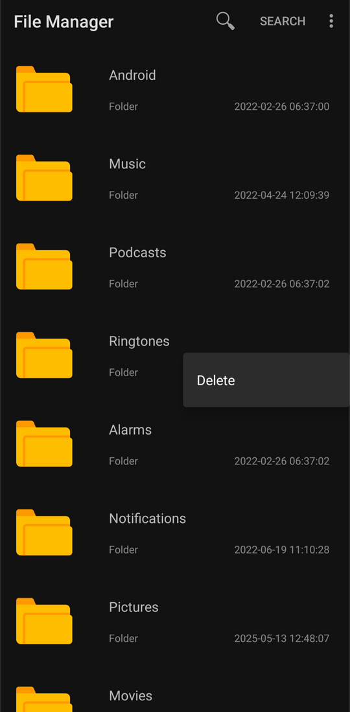
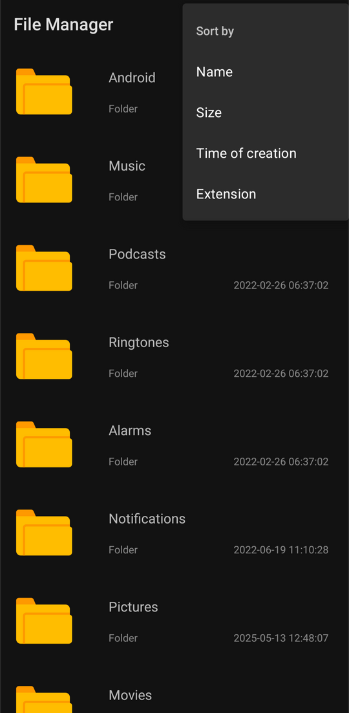
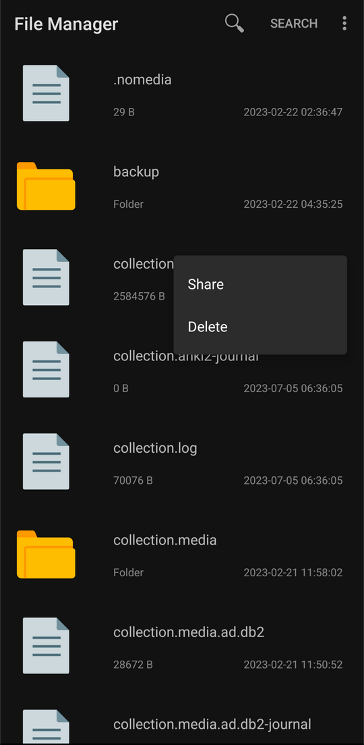
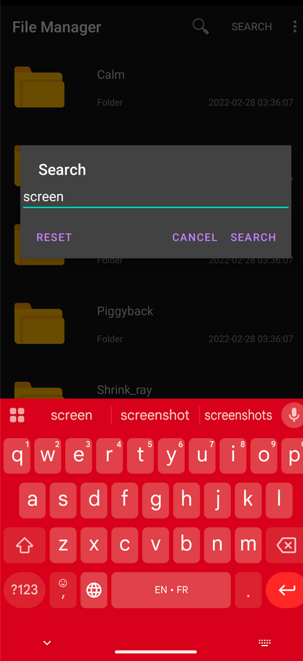
IMPLEMENTATION
HOMESCREEN
SORT
SHARE/DELETE
SEARCH

Slide 8
RELEVANCE TO THE COURSE
FILE HANDLING
PROCESS SYSTEM INTERACTION
IMPLEMENTS FILE SYSTEM OPERATIONS:
OPEN, DELETE, READ, SHARE.
DEMONSTRATES INTERACTION BETWEEN APPLICATION LAYER AND OS STORAGE SYSTEM.
USER ACCESS CONTROL
HANDLES FILE PERMISSIONS & SECURITY (SCOPED STORAGE IN ANDROID)

Slide 9
CONCLUSION
Our File Manager application successfully addresses the core need for efficient file management on Android devices through a comprehensive Kotlin-built solution. The app combines essential features like file browsing, intelligent sorting, and seamless sharing functionality with an intuitive interface that makes everyday file management tasks effortless. This project demonstrates implementation of file management systems as a functional android application.

Slide 10
THANK YOU

